Slide 1
IT1762
Data Structures & Algorithms
Topic 7B
Advanced Algorithms –
Sorting Algorithm

Slide 2
Instructional Learning Objectives
Explain the Sorting Algorithm
Describe Different Sorting algorithms
  Bubble
  Selection
  Inversion

Slide 3

Sorting Algorithms
Sorting is the process of arranging a set of similar pieces of information into ascending or descending order.
  a small portion of that information on which comparisons are based is known as the sort key.

Slide 4
Sorting Algorithms
The efficiencies for judging a sorting algorithm are :
  1) Speed of sorting
    - average time, best time and worse time
  2) Length of time spent on the coding
  3) Memory space for running the algorithm
Speed of sorting is directly related to the number of comparisons and the number of exchanges required.

Slide 5
Sorting Algorithms
Generally, there are 3 classes of sorting algorithms :
  Exchange Sort
    - eg. bubble sort, quicksort
  Selection Sort
    - eg. straight selection sort, binary tree sort
  Insertion Sort
    - eg. simple insertion sort
  We will look at Bubble Sort, Selection Sort and Insertion Sort

Slide 6
Sorting Algorithms Video
Watch these Short video clips to have an overview of the sorting algorithms. The explanation is clear and simple.
Exchange/Bubble Sort (5Mins)
https://www.youtube.com/watch?v=8Kp-8OGwphY
Selection Sort (9Mins)
https://www.youtube.com/watch?v=f8hXR_Hvybo
Insertion Sort (9Mins)
https://youtu.be/DFG-XuyPYUQ?list=PLx3witYKF_5L3YKvXS3p3da-rqwghvW_Q

Slide 7

Sorting Algorithms
1
Bubble Sort
Types of Sorting Algorithms
Bubble Sort
It uses the exchange method of sorting.
The data “bubbles” its way to the top.
When an array of numbers is used, the smaller numbers “bubble” their way to the start of the array.
Simplest to implement but not efficient.

Slide 8
Sorting Algorithms
1
Bubble Sort
Implementing the Bubble Sort algorithm in C#
Assume you had to sort the following data in an integer array.
28 65 59 23 76 32
Bubble sort searches through n numbers using n – 1 passes.
After each pass, the next smallest number has been bubbled to the front.
So, after the first pass the smallest number is at the front.
After the second pass the second smallest number is next, and so on.
Back

Slide 9
Sorting Algorithms
1
Bubble Sort
View this animation, it helps you to understand how Bubble sort works:
http://www.ee.ryerson.ca/~courses/coe428/sorting/bubblesort.html
The Pattern:
  Scan data from back to front.
  At each position, check if value of the current data is less than data in before it (eg if 32 < 76).
  If TRUE, swap their position!
  If FALSE, do nothing.
  Repeat n – 1 times (where n is the number of numbers in the array).
  Note that on the first pass you stop at position 1 (where 65 is above). On the second pass you stop at position 2. And so on. This is because when you get there the numbers in front are already sorted.

Slide 10
Sorting Algorithms
1
Bubble Sort
Bubble Sort Code:
  private void bubble(int []ar)
  {
  int i, j, temp;
  int n = ar.Length;
  for (i=1; i<n; i++)
  // compare back to front
  for (j=n-1; j>=i; j--)
  { // swap if element is
  // out of order
  //in-front > current ?
  if (ar[j-1] > ar[j])
  { // swap
  temp = ar[j-1];
  ar[j-1] = ar[j];
  ar[j] = temp;
  }
  }
  }

Slide 11
Sorting Algorithms
1
Bubble Sort
25 57 48 37 12 92 86 33
n = 8
0
1
2
3
4
5
6
7
48
37
12
92
86
33
i=1
j=7
33
temp

Slide 12
Sorting Algorithms
1
Bubble Sort
48
37
12
92
33
86
i=1
j=6
33
temp
48
37
12
33
92
86
i=1
j=5
48
37
12
33
92
86
i=1
j=4
12
temp
25
12
57
48
37
33
i=1
j=1
12
temp

Slide 13
Sorting Algorithms
1
Bubble Sort
12
25
33
57
48
37
i=2
j=2
12
25
33
37
57
48
i=3
j=3
12
25
33
37
48
57
i=4
j=4

Slide 14
Sorting Algorithms
1
Bubble Sort
Notice that after each pass, the smallest element is in its proper position within the array.
  This method is called the bubble sort because each number slowly “bubbles” up to its proper position.
The total number of comparisons is :
  (n-1) + (n-2) + … + 1 = n*(n-1)/2
  There are n-1 passes and at most n-1 comparisons on each pass.
However, in the preceding sample file of eight elements, the file was sorted after 5 iterations.
How do we modify the code for faster sorting?

Slide 15
Practical 7B
Q1: Bubble Sort
Sort the following numbers in ascending order, using bubble sort. Start your comparison from the right hand side and bubble the smaller values to the left.
10 | 25 | 12 | 55 | 8 | 77 | 3 | 100 | 64 | 37

Slide 16

Sorting Algorithms
2
Selection Sort
A selection sort is one in which successive elements are selected and placed in order.
The largest of the remaining elements is repeatedly selected and placed in its proper position.

Slide 17
Sorting Algorithms
2
Selection Sort
View this animation, it helps you to understand how Selecion sort works:
http://www.ee.ryerson.ca/~courses/coe428/sorting/selectionsort.html
25 57 48 37 12 92 86 33
25 57 48 37 12 33 86 92
25 57 48 37 12 33 86 92
25 33 48 37 12 57 86 92
25 33 12 37 48 57 86 92
25 33 12 37 48 57 86 92
25 12 33 37 48 57 86 92
12 25 33 37 48 57 86 92

Slide 18
Sorting Algorithms
2
Selection Sort
Can you spot the pattern?
How would you implement the algorithm in C# ?
25 57 48 37 12 92 86 33
Pattern:
  Scan unsorted data from front to back to find the largest value.
  Swap the largest value with the data at end (last scan location).
  Go to step 1.

Slide 19
Sorting Algorithms
2
Selection Sort
Selection Sort Code
private void selectSort(int [ ]ar)
{
int i, j, largest, temp;
int n = ar.Length;
for (i=n-1; i>0; i--)
{ // Select largest of ar[0]
// to ar[i] to go in ar[i]
largest = 0;
for (j=1; j<=i; j++)
{
if (ar[j] > ar[largest])
largest = j;
}
// swap
temp = ar[largest];
ar[largest] = ar[i];
ar[i] = temp;
}
}

Slide 20
Sorting Algorithms
2
Selection Sort
The first pass makes n -1 comparisons, the second pass makes n - 2, and so on.
Therefore, the total number of comparisons is n*(n-1)/2.
There is no improvement if the input file is completely sorted or unsorted, since the selection phase is always required.

Slide 21
Sorting Algorithms
2
Selection Sort
Exercise (a):
Sort the data in ascending order and show the result of each pass by using SELECTION Sort.
  37 9 12 18 25 2
Unsort: 37 9 12 18 25 2
Pass 1: [2 9 12 18 25] 37
Pass 2: [2 9 12 18] 25 37
Pass 3: [2 9 12] 18 25 37
Pass 4: [2 9] 12 18 25 37
Pass 5: 2 9 12 18 37 25

Slide 22
Sorting Algorithms
2
Selection Sort
Exercise (b):
Sort the data in ascending order and show the result of each pass by using SELECTION Sort.
  28 65 59 23 76 32
Unsort: 28 65 59 23 76 32
Pass 1: 28 65 59 23 32 76
Pass 2: 28 32 59 23 65 76
Pass 3: 28 32 23 59 65 76
Pass 4: 28 23 32 59 65 76
Pass 5: 23 28 32 59 65 76

Slide 23
Practical 7B
Question 2 :Selection Sort
Sort the following numbers in ascending order, using Selection sort. Start your comparison from the left hand side and select the largest value and put it to the right.
10 | 25 | 12 | 55 | 8 | 77 | 3 | 100 | 64 | 37

Slide 24
Sorting Algorithms
3
Insertion Sort
A insertion sort is one that sorts a set of records by inserting records into an existing sorted file.
[ 25 ] 57 48 37 12 92 86 33
[ 25 57 ] 48 37 12 92 86 33
[ 25 48 57 ] 37 12 92 86 33
[ 25 37 48 57 ] 12 92 86 33
[ 12 25 37 48 57 ] 92 86 33
.
.
12 25 33 37 48 57 86 92
View this animation, it helps you to understand how Insertion sort works:
http://www.ee.ryerson.ca/~courses/coe428/sorting/insertionsort.html

Slide 25
Sorting Algorithms
3
Insertion Sort
What is the pattern for this case?
How would you implement the algorithm in C#?
25 57 48 37 12 92 86 33
Pattern:
  Scan unsorted data from front to back.
  Store first data into sorted space.
  Get next data
  Insert it in the correct spot in the sorted space. (By first moving all the larger values down one space).
  Go to step 3.

Slide 26
Sorting Algorithms
3
Insertion Sort
Insertion Sort Code
//Initially x[0] may be thought
//of as a sorted file of 1
//element.After each repetition
//the elements x[0] through
//x[k] are in order.
void insertSort(int []x)
{
int i, k, y;
for (k=1; k<x.Length; k++)
{ y = x[k];
// Move down 1 spot for all // elements greater than y
for (i=k-1; i>=0; i--)
{
if (y < x[i])
x[i+1] = x[i];
else
break;
}
// Insert y at proper spot
x[i+1] = y;
}
}

Slide 27
Sorting Algorithms
3
Insertion Sort
The total number of comparisons in the simple insertion sort is also n*(n-1)/2.
If the initial file is sorted, only one comparison is made on each pass.
If the file is initially sorted in the reverse order, the sort is (n-1) + (n-2) + … + 1.
However, the insertion sort is still usually better than the bubble sort.
The closer the file is to sorted order, the more efficient the simple insertion sort becomes.

Slide 28
Practical 7B
Question 3a:Insertion Sort
Sort the data in ascending order and show the result of each pass by using INSERTION Sort.
  37 9 12 18 25 2
Unsort: 37 9 12 18 25 2
Pass 1:[37] 9 12 18 25 2
Pass 2:[ 9 37] 12 18 25 2
Pass 3:[ 9 12 37] 18 25 2
Pass 4:[ 9 12 18 37] 25 2
Pass 5:[ 9 12 18 25 37] 2
Pass 6:[ 2 9 12 18 25 37]

Slide 29
Practical 7B
Question 3b:Insertion Sort
Sort the data in ascending order and show the result of each pass by using INSERTION Sort.
  28 65 59 23 76 32
Unsort: 28 65 59 23 76 32
Pass 1:[28] 65 59 23 76 32
Pass 2:[28 65] 59 23 76 32
Pass 3:[28 59 65] 23 76 32
Pass 4:[23 28 59 65] 76 32
Pass 5:[23 28 59 65 76] 32
Pass 6:[23 28 32 59 65 76]

Slide 30
Practical 7B
Question 3C: Insertion Sort
Sort the following numbers in ascending order, using insertion sort. Start your comparison from the left to right.
10 | 25 | 12 | 55 | 8 | 77 | 3 | 100 | 64 | 37

Slide 31

Practical 7B
Question 4
Visit MSDN library website
  http://msdn.microsoft.com/en-us/library/default.aspx
Search for “bubble sorting” in MSDN website

Slide 32
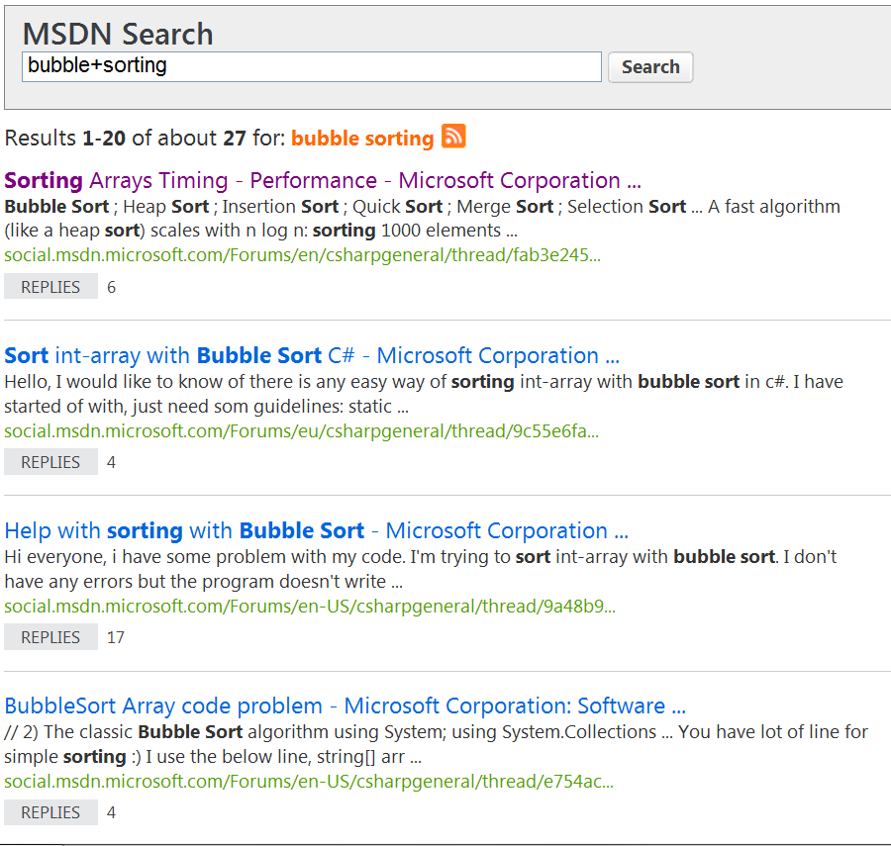
Practical 7B
Read the findings and articles to see how you can apply sorting in your application.

Slide 33
IT1762
Data Structures and Algorithms
End of Topic 7B
Advanced Algorithms
- Sorting Algorithms

